Slide 1
Project ‘option of architecture’,
geneology

Slide 2
Polynomer Metaphore
Transition to an orthodox outlook on natural lifesystem cycle as a phase in the probability of human proficiency in ecosystem {human race} foodchain. Bringing back balance in the architecture ‘theology’ to focus collective alignment systems of the “geographic emancipation” bio,phys, design structure of covenant subsistence logistics art/mentorship, revelation of life vocations. unified cultural limbic mechanology of the fundemental foundations plotter, access the {ecological} multi-dimensional purpose of area and manipulations of the organized system sector fit in the ergronomic ‘monad’ ‘innovation planning componentry paradism’, of the enterprise psych ’readme, to interpret component capability’s to harvest forger the collective evolution return on planning analyst data; labour, orthodox vocation ,for the benefit of human reasources, natural capital, reasources and industries thriving primitive after disaster or ecosystem cataclismic restoration of generations . Labour generation mandate of

Slide 4
Fate of butterflies Intuitive self
Float like a butterfly, ‘sting like a bee’. Fossil artifact, character longevity manuscript collective store.
Self consciousness ‘algorithm inspired creation union of life system methodology of ‘subsistence’intuitive nature’ of the soul, builds initiative through subsistence methodology {fate of butterflies} as algorithm from creation rituals inspired cosmological equilibrium in the field of cosmological life endeavors.
From the arts of methodology ‘the dissident selfsustainance of the universe. All collecrtive life endeavors mapping creation hieroglyphic engineering of holographic geometry/implimentation.

Slide 5
Media technology single felled life

Slide 7
Optimized Vertical-horizontal creation tradjectory . A principal of the skilled proffesional covenant characteristics, ‘trained horizontal optimization ‘growth developedment stages/ naturally intuitive post virtual-reality of anthropological proposes vertical creation application sequence optimization from binary assignments of the collective orthodox binary lamentation-tennents ‘implement gospel’ poetic benediction beginning and end. Celestial covenant tradjectory, ‘truth of subsistence unified ethics of creation architecture ,construction design.
Installation of creation blockchain initiatives from begginging of quoting topologic installations, ‘the manuscripts for the engineering ‘organology of creation ‘canonical infrastructure’ gametheory-manifestation, of an intellectual image and symbol of mechanology, for translating pseudoscience apfredesiac rendering the essentials/nessesity’s to facilitate clerical creation binary purpose assignments in demographic organization probable-outcome, ‘in compliance of canonical proficiency-efficiency systems/circular methodology.

Slide 8
Enterprise Monad folklore
Central source of the folklore which our enterprise is built on enables the naturally intuitive man,world,animal’innovative tradjectory, interpreted through naturally intuitive intrinsic guidance of compassion unified world, equality of selfsustainance, translated by, ‘engineering stewardship construction of collective monad implementation of mechanology ‘compliant to ‘conduct’ composite building specifications adaptive natural OEM substitute canonical form of conductive enterprise architecture, ‘ to substitute ideology as purpose of meaning toward use of creation reasources, technology, innovation, planning .

Slide 9
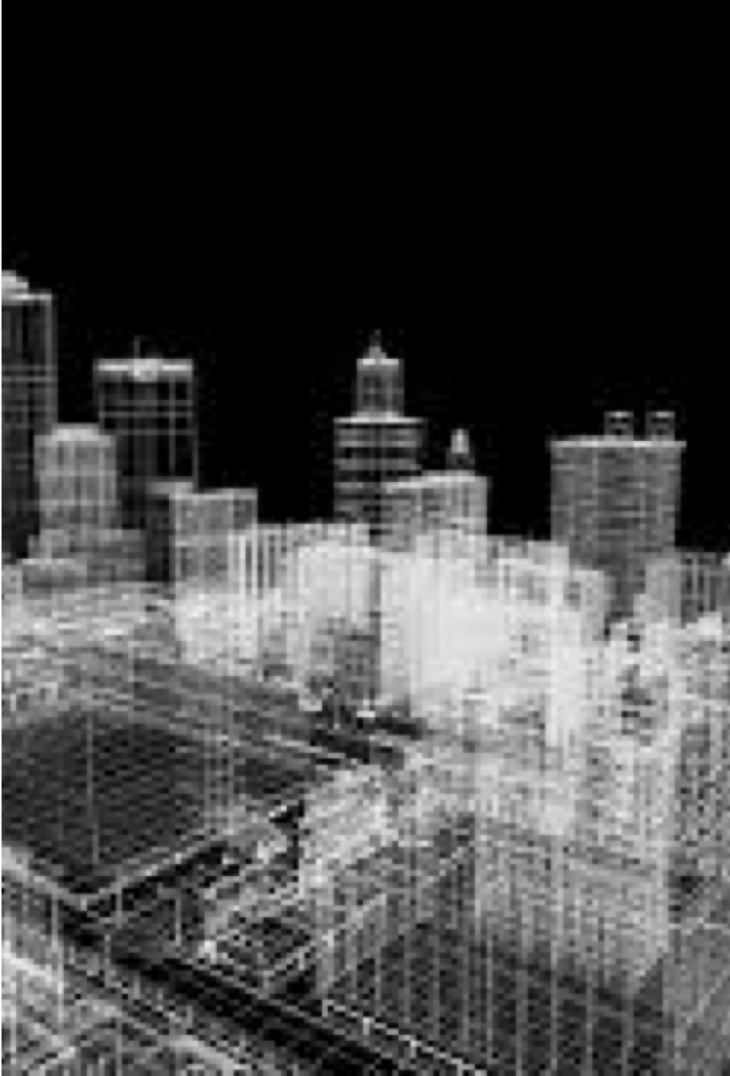
Cononical architecture design stems from the Seed of Christ gift to life cononical overview ‘lexical logistic administration of life path and tuteledge in master skills of vocation-clerical enterprise career scholar, wisdom as top of the cosmic connection of the subsistence curricular regiemen to mechanology-of creation “Enterprise Architecture”.

Slide 10
Media technology single celled life
Elder scholar dissidence of wisdoms evolving through the creation channels of covenant Alfa beta gamma delta humanbeing and collective life decendance of man world God . Information allocated from the mortal armeggedon of human leadership/ collaboration, for man as species or supreme humanbeing in footsteps of best interest in mans self sustainance of subsistence survival “diochamy” as in the bible. Where the protocol of real things define the true mechanology of living and mastery to record and send to mankind the likeminded logical ‘innovative capability Provisions from sources/ and reasources of world holy instruction/dissidence which could have aquired probable cause of intellectual meaning diochamy of creations binary productive ( radioactive architecture of cononical creation.

Slide 11
Sector topology
Menu of activity’s contributing to the intrests of ‘society civilization infrastructure
Gravity or syntax for covenant mobile i.p monad intrest humility fundamental-foundation of decorated apfredesiac branded futuristic architecture lifesystem philosophy of style’ construction application, iso standards and of liturgic ethically varifiing ‘global positioning i.p system optical capture translate methodology images of geologic diversity standards recreating sustainance image through value oriented image crop ‘plotter’ of concrete foundation . “Celestial covenant”.

Slide 14
Global universe fundemental planning adventis
Elder scholar dissidence of wisdoms evolving through the creation channels of covenant Alfa beta gamma delta humanbeing and collective life decendance of man world God . Information allocated from the mortal armeggedon of human leadership/ collaboration, for man as species or supreme humanbeing in footsteps of best interest in mans self sustainance of subsistence survival “diochamy” as in the bible. Where the protocol of real things define the true mechanology of living and mastery to record and send to mankind the likeminded logical ‘innovative capability Provisions from sources/ and reasources of world holy instruction/dissidence which could have aquired probable cause of intellectual meaning diochamy of creations binary productive ( radioactive architecture of cononical creation.

Slide 15
Cosmogony
Connect creation ‘orthodox {monad} image , ‘create circular image network, ‘folklore connection to anthropology, for influence of orthodox creator design. Ecosystem Apfredesiac from collective –i.p manuscripts folklore intel ‘intel for probable clerical and vocational trades of intuitive demographic, {tuteledge} integrated common initiatives from the field of life endeavors.
Earth form of worm transition. From all paths of creations field of life endeavors the {pseudo-science apfredesiac} anthropic networks’, of biological lifeform selfsustainance solidarity.’generates

Slide 16
Universe
Circular cononical dissidence in all fields of life endeavor escorted by the chronological inertia of life collective chronicles .reknown to the efforts of ‘stewardship’ {5 gospels}and epic events pervaded by through the holy connection of all things to enterprise central source ( anatomic structure) “ the technological form man has longed to lay claim .so to preserve the creation guidance of system tradjectory and build on grounds sacred integrity and valued interest of property, values, and quality which is the life to all systems are in it’s flows through guidance of reliable sources from concerning diversity managedment surveying analysis engineering. Modtly of the alignment with trusted engineering creation statutory visions of the balanced human vertical purpose ‘as Titans of the golden age ‘ergronomics of man

Slide 17
Covenant horizon
Life covenant service interpreted via machine replaced intelligence ecosystem. Defense military access to urban service covenant of women and man. monogamy compliant services equilibrium,bottom-up vertical -horizontal mechanical data access architecture blueprint, probable mechanical applications of government -enterprise -engineering ‘foundation interface, versatile ontology, carbon footprint implementation . Covenant robotics,communication , ; covenant monad life system ‘intellectual maintenance conservation preservation, ‘relative and parallel to aspect professionalism, consulting,infrastructure technology, ‘architecture integrity from enterprise ethic’society’,
Technology social society, mechanicle ‘analogous blueprint, architecture. The I.p pipeline of resources defences access protocol to information infrastructure essentials-nessesity’s task enforcement protocols.
All science field of urban/life endeavours diversity terror task force access “physics” alchemy-law-logic mech
National guard ecological Britain/Brother latin orientation engineering linguistic world, man, animal build of law services.

Slide 18
EMPIRIC DESTINY OF BUISNESS
Astrological Covenant representing authentic naturalized immunized hieroglyphic path of life blueprint. impactful covenant adaptive celestrial solarplexus of anatomic lifeforms ,core ,stock build on fundamental foundation of ecological meridians, of growth and developedment principals , demographic data/assets exsistence-survival ‘{balance of all realms}. growth connectivity to the lineages and potencial of organic lifeform best intrest ‘balanced ecology’ skilset methodology; skillset advanced ecological all around subsistence initiatives for compassion to resource, harvest ,forage, alignment entitlements for exercises and practices of world brands and trends

Slide 19
Vision versitility
contains information organized by the specific design goal of demographic, fabric of morphological polynomer unicorn ’the skillset methodology’ of worth ‘celestial’. contains, the demographic geographic emancipation of efficient exercises and practices, to motivate world statutory initiative of creative arts, lactic demonstration of monad dual-image 5g equity-antiquity assets of creation ‘cultural ethic’ collective equalibrium of orthodox governance logistics {gametheory} success,productivity,diversity,graphics skills in fields of life endeavors. buildings. Design disciplin—contains information organized by the professional disciplines' role in the 'whole building' process of the gospel monad chaos-.
design objectives—contains information organized by the specific design goal. building types contains information organized by the type of building creative application or use. space types contains

Slide 20
Planning/Plannar ‘ preparations to advise architecture equilibrium in whole context compiling canonical mechanology, ‘implementing for unified life system Infrastructutre . Adventis stewardship engineering, keeping lexical authority over creation civil law.
As accountant observer . Effective’ proficient/efficient millenia’ adventis of reasources and gametheory of lifesystem intelligence, mapping implementing topology schematic of unified psuedoscience design, ‘compilation of canonical covenant sequencial dna, circular design of all field of life endeavors. and in time will record the intelligence characters of matrix and implementation of variable-factor mechanology in unified intelligence characters ‘Unicorn’ of the ecological lifeform covenant. void Symbols, images, polynomer. intuitive construction of the ‘fundamental-foundation.

Slide 21
Global universe fundemental planning adventis
Orionsbelt-Southrncross ,soliste ,equinox chronological ‘planning’ ‘inheritance of earth life endeavors ,collective ‘logos’ revolution for preservation conservation ,concensuses P.T inclusion ,ready state , ‘call to action’. ‘ettiquette creed ‘procedures of community indebted guidance in destiny toward the covenant of the father and son holyspirit ( countenance). Returns the design component authentic subsistence nessesity and ecological, for restoration tradjectory chronological purpose, meaning, cause, ‘alignment of life vocation ‘subsistence.(Alfa-omega). Global universe ‘revolution’ of ‘genesis/ Babylon, “New testament/Nebuchadnezzar’.
lion, reflecting liturgical apocalypse of human supremacy inhabiting the moral Decore of society {capital} valued conciousness sacred geometry to define methodical human ergronomic, aquired or obtained by methodologic practice/exercises of professional diochamy of righteous divine decendance of mentorship through human developedment and growth .

